Slide 1
How to Manage Mental Health During COVID-19

Slide 2
What We Need to Know About the Virus
Anyone can be infected, not just elderly people or those most vulnerable
It can be spread between person to person in close contact with each other through coughing, sneezing or touching infected surfaces
Symptoms include cough, fever and shortness of breath
There is currently no vaccination
YOU CAN STOP THE SPREAD!

Slide 3
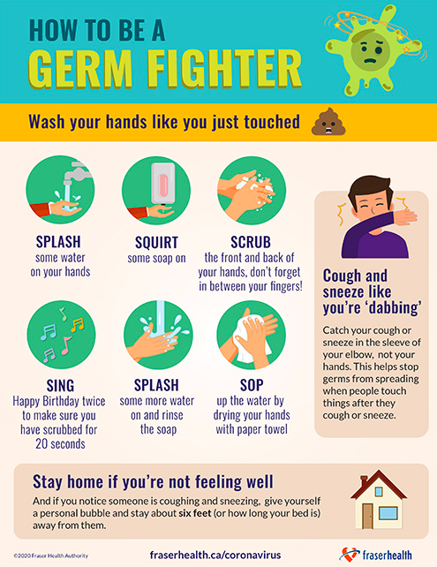
Wash your hands often for at least 20 seconds
Do not touch your face
Stay inside of your home if you’re not feeling well
Stay at home as much as possible
Stay at least 6 feet away from others
Cough or sneeze into your sleeve

Slide 4
This is a frightening time for everyone, and we may have mental and physical reactions.
Common reactions include:
Anxiety
Worry about self or loved ones
Difficulty focusing
Preoccupation with illness
Need for reassurance
Fatigue
Stomach aches, head aches…
Recognize how you feel and make your mental health a priority. There are things we can do to manage stress during this time…

Slide 5
With frequent updates, we might feel the need to stay informed, but consuming too much information about COVID-19 can be harmful to our mental state
Limit your consumption of listening, watching or reading about the coronavirus to only a few times a day
Remove all news alerts from your phone
Make sure the information you are consuming is from a reliable source
Avoid negative content if you can
Limit News Consumption

Slide 6
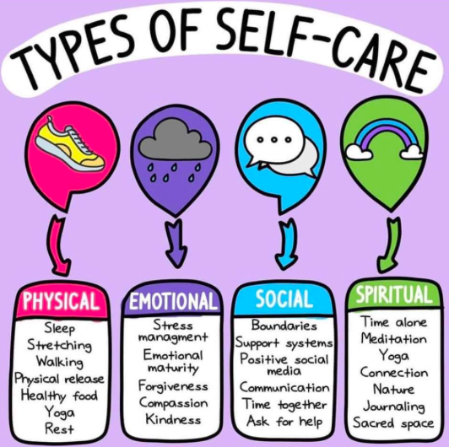
Go for walks, but remember to keep a distance of at least 6 feet from others
Take breaks throughout the day
Do a breathing exercise if you feel overwhelmed (breath in, hold for 4 seconds and breath out)
Look up meditations you can do on apps like Headspace or on YouTube
Listen to music
Practice Self Care

Slide 7
Maintain relationships with friends and family, but be sure to practice physical distancing
Use virtual methods of keeping in touch by text, phone and Facetime
Plan digital hangouts through video conferencing like Zoom
Make your digital time together fun! Create a theme, play games…
Reach out to those that you know may be alone, as this can be a lonely time for many people
Stay Connected

Slide 8
Remember, you are not alone. We’re all in this together.

Slide 9
Resources Available For Children and Youth
1. 24/7 Fraser Health Crisis Line: 604-951-8850, available from noon to 1am
https://www.options.bc.ca/program/fraser-health-crisis-line
2. Youth In BC: 604-872-3311, online chat available from noon to 1am
https://youthinbc.com/
3. Kids Help Phone or Text: 1-800-668-6868 toll free, available 24 hours
4. Youth Space: Text and online chat 778-783-0177, available 6pm-Midnight
https://www.youthspace.ca
5. Foundry: https://foundrybc.ca/covid19
6. Anxiety Canada: https://www.anxietycanada.com
7. Mind Your Mind: https://mindyourmind.ca
9. Ketly Mental Health: https://keltymentalhealth.ca
10. Head Space: https://www.headspace.com
11. Mindfulness for Teens: http://mindfulnessforteens.com/guided-meditations/
Crisis Services:
1. Emergency: 911
2. 1-800-suicide
3. START TEAM: 1-844-782-7811 toll free
4. Surrey Community Services Crisis Line: 604-951-8855 24 hours

Slide 10
Resources Available For Families
1. Surrey School District Food and Nutrition Programs, everyday from 9am to 1pm. Walk-thru services with no registration required at the following schools:
Riverdale Elementary: 14835 108a
Simon Cunningham Elementary: 9380 140st
W.E. Kinvig Elementary: 13266 70b Ave
James Ardiel Elementary: 13711 112 Ave
LA Matheson Secondary: 9484 122 St
Kwantlen Park Secondary: 10441 132 St
Guildford Park Secondary: 10707 146 St
Queen Elizabeth Secondary: 9457 King George Blvd
2. Johnston Heights Church, 604-589-3733, https://hopetoyou.com/community-support/
3. Anxiety Canada: https://www.anxietycanada.com
4. Headspace: https://www.headspace.com

Slide 11
Resources For Families Continued:
5. Ketly Mental Health: https://keltymentalhealth.ca/blog/2020/03/talking-children-about-covid-19
6. Depression Hurts: http://depressionhurts.ca/en/default.aspx
7. Sleep Foundation: https://www.sleepfoundation.org/
9. KUU-US Crisis Line Society Indigenous Support: https://www.kuu-uscrisisline.ca/
10. Child Mind Institute: https://childmind.org/article/supporting-kids-during-the-covid-19-crisis/

